Slide 1

Task Management App for Restaurants
MainActivity.kt – Code Explanation
Presented by: Team 9

Slide 2
Overview
MainActivity.kt serves as the entry point for the Restaurant Task Management App.
It integrates Jetpack Compose to build a modern, responsive UI.
Key functionalities include:
- Viewing shift schedules
- Assigning tasks to workers
- In-app chat for team communication
The app is organized with tabs for intuitive navigation.

Slide 3

MainActivity Setup
The MainActivity class extends ComponentActivity.
Inside onCreate(), the app sets the content using setContent.
This initializes the UI with the TaskManagerApp() composable.
Jetpack Compose is used, eliminating XML layout files entirely.

Slide 4

TaskManagerApp() Function
This function manages the tab layout and navigation.
- selectedTab is a state variable determining the current screen.
- TabRow displays the available tabs (Shifts, Tasks, Chat).
- When a tab is selected, it displays the corresponding screen.
- Uses Column and Spacer for UI layout.

Slide 5
ShiftScheduleScreen()
Displays a static list of workers and their weekly shifts.
- Uses LazyColumn for a vertically scrollable list.
- Each shift is shown as a text item.
- Can be extended to use live data from a backend or database.

Slide 6
TaskAssignmentScreen()
This screen shows task assignments for staff.
- Each entry pairs a worker with their assigned duty.
- Uses LazyColumn for efficient rendering.
- Ideal for managers to review or update task distribution.

Slide 7

ChatScreen()
Enables internal messaging between staff and management.
- A list of messages is maintained using a mutableStateList.
- Users can type into a TextField and press a Button to send messages.
- Messages are displayed with padding and background styling in a Column.
- Real-time chat functionality can be added using Firebase or WebSocket.

Slide 8
Jetpack Compose Elements Used
- Column & Row: Structuring vertical and horizontal UI elements.
- LazyColumn: Efficient rendering of long lists.
- Text, TextField, Button: Standard input/output UI components.
- remember & mutableStateOf: State management within composables.
- Modifier: Controls layout, alignment, padding, and size.

Slide 9
Why Compose Was Chosen
- Jetpack Compose is the modern UI toolkit for Android.
- It allows for declarative UI code, making it clean and maintainable.
- State-based rendering ensures the UI updates automatically.
- Excellent for building responsive and dynamic interfaces quickly.

Slide 10
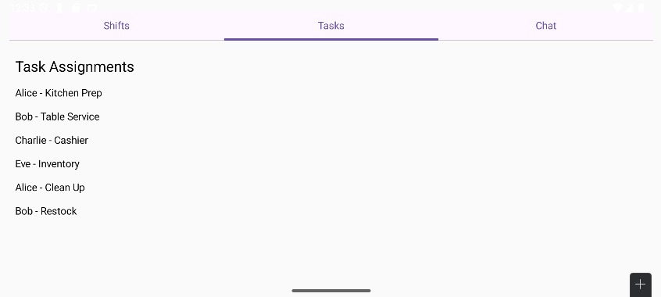
🗓️ Shift Schedule View – Displays weekly assignments per employee

Slide 11
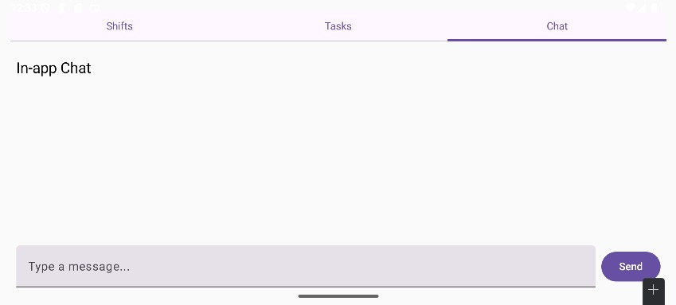
🧾 Task Assignment View – Lists duties per worker

Slide 12
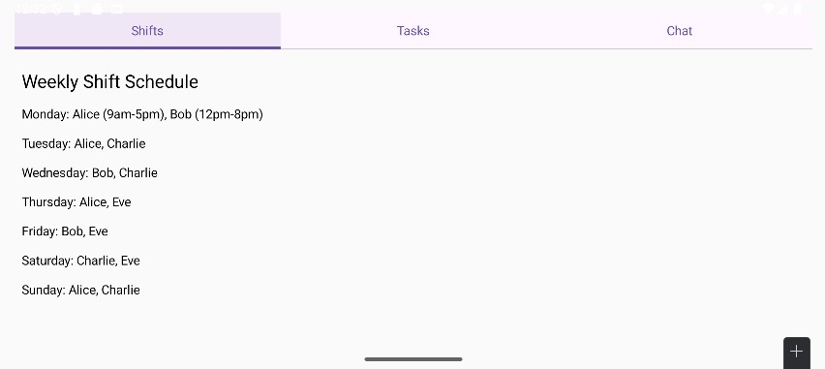
💬 In-App Chat – Enables internal messaging between staff

Slide 13
Conclusion & Next Steps
- MainActivity.kt successfully integrates all three core features: Shifts, Tasks, and Chat.
- Fully implemented using Compose – no XML layouts needed.
- Can be expanded with backend integration, user authentication, and persistent storage.
- Next steps include connecting to a database, enabling real-time sync, and user login functionality.

